Slide 1

Python Fundamentals
Course Introduction
SoftUni Team
Technical Trainers
Software University
https://softuni.bg/

Slide 2
Have a Question?
sli.do
#fund-python

Slide 3












SoftUni Diamond Partners

Slide 4
Table of Contents
Course Objectives
Training Team
Course Organization
Course Schedule
Evaluation Criteria
4

Slide 5

Course Objectives

Slide 6
Python Fundamentals Objectives
Working with linear data structures
Lists
Defining functions and simple classes
Working with dictionaries
Processing and manipulating strings
Regular expressions
6

Slide 7

Training Team

Slide 8
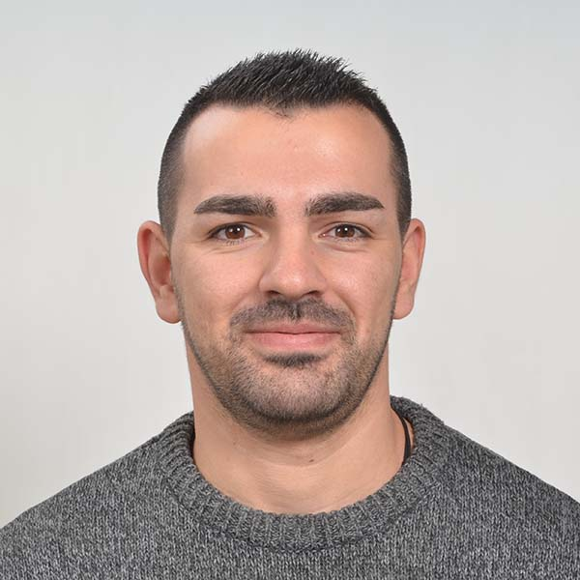
Mario Zahariev
Top student @ SoftUni
Master of Cyber Security
5+ years of experience on Python
Interested in JavaScript, Artificial Intelligence and Go
Involved in researches related to artificial intelligence and machine learning

Slide 9
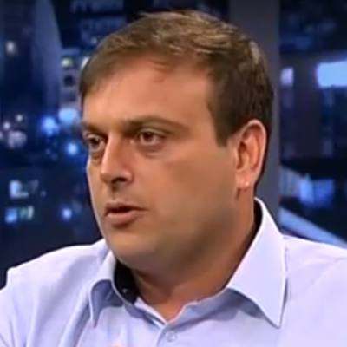
Ivan Shopov
DevOps & Software Developer @ IBM
Top Student @ SoftUni
Technical Trainer @ SoftUni
Interested in coding with Python 3

Slide 10

Course Organization

Slide 11
Python Fundamentals Module
08-Jan-2024
18-Feb-2024
31-Mar-2024
04-Apr-2024
08-Apr-2024
Python Fundamentals
12 weeks * 3 times/week
12 credits
Start: 08-Jan-2024
Mid Exam: 18-Feb-2024
Final Exam: 31-Mar-2024
Theoretical Exam: 31-Mar-2024
Re-Take Exams
Mid Exam Retake: 04-Apr-2024
Final Exam Retake: 08-Apr-2024
Theoretical Exam: 08-Apr-2024

Slide 12
Practical Programming Exam
Mid Exam - 4 hours
3 practical problems
Conditional Statements and Loops
Linear Data Structures – Lists
Final Exam - 4 hours
3 practical problems
Dictionaries
Strings and Text Processing
Regular Expressions
12

Slide 13
Theoretical Exam
You will have 30 minutes once you enter
Multiple-choice with 1 correct answer
Test will be in English
Automated quiz system
Available online on the day of the practical exam
You can submit your answers just one time
13

Slide 14
Course Scoring
Practice grade:
Theory grade:
SoftUni Certificate: 5.00 from Practice
CPE Certificate: 3.00 from Practice + Theory
Practical Mid Exam
Practical Final Exam
Homework
40 %
60 %
+5 %
Theoretical Exam
100 %
14

Slide 15

Homework Assignments & Exercises
Your homework is mainly work in class
Lesson days → slides + live demos + exercises
Exercise days → only exercises
How to submit your homework?
Submitted in the judge system
Do your homework when it's due
Assignments pile up quickly

Slide 16


Learn to Search in Internet
The course assignments require to search in Internet
This is an important part of the learning process
Some exercises intentionally have no hints
Learn to find solutions!
Software development includes everyday searching and learning
No excuses, just learn to study!
Developers learn new technologies, tools, languages every day!

Slide 17



Course, Forum and FB Group
Official website:
Official discussion forum:
Official Facebook group:
Python Community Facebook group:
https://softuni.bg/trainings/4379/programming-fundamentals-with-python-january-2024
https://softuni.bg/forum/categories/784/python-fundamentals
https://www.facebook.com/groups/ProgrammingFundamentalswithPythonJanuary2024
https://www.facebook.com/groups/SoftUniPythonCommunity

Slide 18









Questions?

Slide 19
Trainings @ Software University (SoftUni)
Software University – High-Quality Education, Profession and Job for Software Developers
softuni.bg, about.softuni.bg
Software University Foundation
softuni.foundation
Software University @ Facebook
facebook.com/SoftwareUniversity
Software University Forums
forum.softuni.bg
Notes:
19

Slide 20

License
This course (slides, examples, demos, exercises, homework, documents, videos, and other assets) is copyrighted content
Unauthorized copy, reproduction or use is illegal
© SoftUni – https://softuni.org
© Software University – https://softuni.bg
Notes:
20

